Slide 1
UK Gameplan

Slide 2
Network
Slow speeds
No Connection
WIFI issues
Streaming
Things we check ask the customer, check in the station, etc.
Check account status (arrears, invoice date, coverage period) Check software version and e-SIM device compatibility Check if SMS, calls, and data are all not working Check for any error messages Confirm if device is online Check the signal strength Check the device's make and model Confirm if issue affects all services or specific app/site Ask when the issue started Confirm if device is UK purchased Check customer location; is the customer in UK? Proceed with Troubleshooting.
If the customer is in arrears – This is not a network issue. Please proceed with billing issue.
If the customer is not in the UK – Mention that we only cater UK customers, then continue with other concerns.
Notes:
[Sources] - Visual style guide reference provided by user: /mnt/data/LoopDL support PDD - UK 25.pptx - Trustpilot Guidelines for Businesses (Feb 2026): https://corporate.trustpilot.com/legal/for-businesses/guidelines-for-businesses/feb-2026 - Trustpilot Help - Can businesses reply to reviews?: https://help.trustpilot.com/s/article/Can-businesses-reply-to-reviews - Trustpilot Help - Engage with your reviewers: https://help.trustpilot.com/s/article/Engage-with-your-reviewers - ASA guidance on subscription offers and free trials: https://www.asa.org.uk/news/thinking-outside-the-subscription-box.html - ASA promotional offer guidance PDF: https://www.asa.org.uk/static/uploaded/43ffc927-a744-42b1-847956f4067cbb6b.pdf [/Sources]

Slide 3
Network
Slow speeds
No Connection
WIFI issues
Streaming
Troubleshooting Steps Loop
Run a speed test Optimize the connection Reboot the device Get the customer’s exact location if escalation is needed Factory reset as last resort- check with TL first. e-SIM Confirm if SMS, calls, and data are all not working Restart the device; reboot (Turn your phone off, then turn it back on) Make sure the customer is using the same phone we are troubleshooting or the device is present upon the call. Check the APN settings. Toggle airplane mode (steps on next slide)
If issue insists, get the error and ask the customer to send it via email. Then escalate to MO under network issue.
Notes:
[Sources] - Visual style guide reference provided by user: /mnt/data/LoopDL support PDD - UK 25.pptx - Trustpilot Guidelines for Businesses (Feb 2026): https://corporate.trustpilot.com/legal/for-businesses/guidelines-for-businesses/feb-2026 - Trustpilot Help - Can businesses reply to reviews?: https://help.trustpilot.com/s/article/Can-businesses-reply-to-reviews - Trustpilot Help - Engage with your reviewers: https://help.trustpilot.com/s/article/Engage-with-your-reviewers - ASA guidance on subscription offers and free trials: https://www.asa.org.uk/news/thinking-outside-the-subscription-box.html - ASA promotional offer guidance PDF: https://www.asa.org.uk/static/uploaded/43ffc927-a744-42b1-847956f4067cbb6b.pdf [/Sources]

Slide 4
Network
Slow speeds
No Connection
WIFI issues
Streaming
Troubleshooting Steps Toggle Airplane Mode Turn Airplane Mode on for 10 seconds, then turn it off to force a network scan. Manual Network Selection (iPhone) Go to Settings > Mobile Service/Cellular > Network Selection. Turn off Automatic, then select Vodafone from the list. Manual Network Selection (Android) Go to Settings > Connections > Mobile Networks > Network Operators. Turn off Select automatically, then choose Vodafone. Check APN Settings Make sure the Access Point Name (APN) is set to: wap.vodafone.co.uk Toggle Airplane Mode Again Turn Airplane Mode on for 10 seconds, then turn it off again.
If the customer does not have an extra phone :
Mention the troubleshooting steps and callback after 3 minutes.
Notes:
[Sources] - Visual style guide reference provided by user: /mnt/data/LoopDL support PDD - UK 25.pptx - Trustpilot Guidelines for Businesses (Feb 2026): https://corporate.trustpilot.com/legal/for-businesses/guidelines-for-businesses/feb-2026 - Trustpilot Help - Can businesses reply to reviews?: https://help.trustpilot.com/s/article/Can-businesses-reply-to-reviews - Trustpilot Help - Engage with your reviewers: https://help.trustpilot.com/s/article/Engage-with-your-reviewers - ASA guidance on subscription offers and free trials: https://www.asa.org.uk/news/thinking-outside-the-subscription-box.html - ASA promotional offer guidance PDF: https://www.asa.org.uk/static/uploaded/43ffc927-a744-42b1-847956f4067cbb6b.pdf [/Sources]

Slide 5
Network
Slow speeds
No Connection
WIFI issues
Streaming
If the issue persist, escalate with the info below: Customer's exact location (Address) Make and model (eg. Iphone 13, Google Pixel 10 pro) eSIM or cellular settings (does the customer connect through Vodacom or 3?) Loop: Serial number e-SIM MSISDN
Notes:
[Sources] - Visual style guide reference provided by user: /mnt/data/LoopDL support PDD - UK 25.pptx - Trustpilot Guidelines for Businesses (Feb 2026): https://corporate.trustpilot.com/legal/for-businesses/guidelines-for-businesses/feb-2026 - Trustpilot Help - Can businesses reply to reviews?: https://help.trustpilot.com/s/article/Can-businesses-reply-to-reviews - Trustpilot Help - Engage with your reviewers: https://help.trustpilot.com/s/article/Engage-with-your-reviewers - ASA guidance on subscription offers and free trials: https://www.asa.org.uk/news/thinking-outside-the-subscription-box.html - ASA promotional offer guidance PDF: https://www.asa.org.uk/static/uploaded/43ffc927-a744-42b1-847956f4067cbb6b.pdf [/Sources]

Slide 6
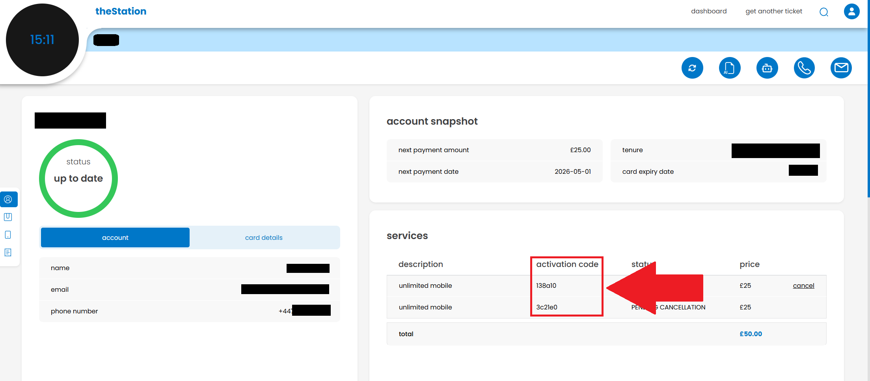
Network
Activation
Things we check ask the customer, check in the station, etc. Loop Set up your loop by completing the Android setup process on the device. Tap the activation widget on the loop's home screen. Scan the QR code displayed on your loop with your phone. Follow the activation prompts on the LoopDL website, then enter your activation code, which was sent during purchase
Do not proceed if the customer cannot verify the account.
If the e-SIM is on another device, continue with:
Transfer e-SIM / e-SIM not working. Otherwise, continue troubleshooting.
Notes:
[Sources] - Visual style guide reference provided by user: /mnt/data/LoopDL support PDD - UK 25.pptx - Trustpilot Guidelines for Businesses (Feb 2026): https://corporate.trustpilot.com/legal/for-businesses/guidelines-for-businesses/feb-2026 - Trustpilot Help - Can businesses reply to reviews?: https://help.trustpilot.com/s/article/Can-businesses-reply-to-reviews - Trustpilot Help - Engage with your reviewers: https://help.trustpilot.com/s/article/Engage-with-your-reviewers - ASA guidance on subscription offers and free trials: https://www.asa.org.uk/news/thinking-outside-the-subscription-box.html - ASA promotional offer guidance PDF: https://www.asa.org.uk/static/uploaded/43ffc927-a744-42b1-847956f4067cbb6b.pdf [/Sources]

Slide 7
Network
Activation
Things we check ask the customer, check in the station, etc. e-SIM Please ensure the following before proceeding with installation: Use a stable internet connection (Wi-Fi or strong 5G). Confirm the device is e-SIM compatible. Ask the brand and model and verify e-SIM compatibility Ensure the device is updated to the latest iOS or Android version. Verify if it was purchased in the UK Check that the device has not reached its maximum number of stored e-SIMs (some Android devices allow 5–7 profiles, but only one can be active at a time). Device Troubleshooting: Restart the device and attempt the installation again. If issues persist, delete unused e-SIM profiles if applicable.
If the esim is on another device, proceed with:
Transfer e-SIM / e-SIM not working.
Otherwise, proceed with troubleshooting.
Notes:
[Sources] - Visual style guide reference provided by user: /mnt/data/LoopDL support PDD - UK 25.pptx - Trustpilot Guidelines for Businesses (Feb 2026): https://corporate.trustpilot.com/legal/for-businesses/guidelines-for-businesses/feb-2026 - Trustpilot Help - Can businesses reply to reviews?: https://help.trustpilot.com/s/article/Can-businesses-reply-to-reviews - Trustpilot Help - Engage with your reviewers: https://help.trustpilot.com/s/article/Engage-with-your-reviewers - ASA guidance on subscription offers and free trials: https://www.asa.org.uk/news/thinking-outside-the-subscription-box.html - ASA promotional offer guidance PDF: https://www.asa.org.uk/static/uploaded/43ffc927-a744-42b1-847956f4067cbb6b.pdf [/Sources]

Slide 8
Network
APN Settings
Things we check ask the customer, check in the station, etc. The loop uses an e-SIM (no physical SIM), and activation of the e-SIM happens automatically during the device setup via the LoopDL app. Loop No manual APN setting needed e-SIM the e-SIM profile and network settings are provisioned automatically as part of the activation process in the LoopDL app

Slide 9
Network
Sim Swap
Things we check ask the customer, check in the station, etc. Verify reason for Loop Sim Swap, make sure to exhaust all troubleshooting steps. Loop Verify the device ID to process Sim Swap, do not take action without speaking to the customer. e-SIM 1. Identify the customer's device_id 2. Use the eSIM installation status tool to check the current eSIM state on the device. 3. If needed, initiate a new eSIM profile installation or swap via the backend system for that device_id.Inform the customer that the number may change due to the SIM swap 4. Confirm activation and connectivity of the new eSIM after the swap. 5. Inform the customer that the swap will be transparent and they may need to restart the device.
Before processing sim swap, gain approval from support, as this is a last resort for activation and similar issues.
Verify if there is a ported number. If there is, do not continue with the sim swap since the ported number will be lost.

Slide 10
Network
SMS and Voice Query
Things we check ask the customer, check in the station, etc. Check if e-SIM is activated Check e-SIM settings on phone Troubleshooting e-SIM Check the signal Check Messaging and Call settings Restart the phone

Slide 11
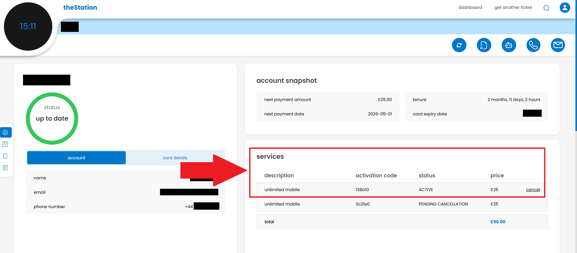
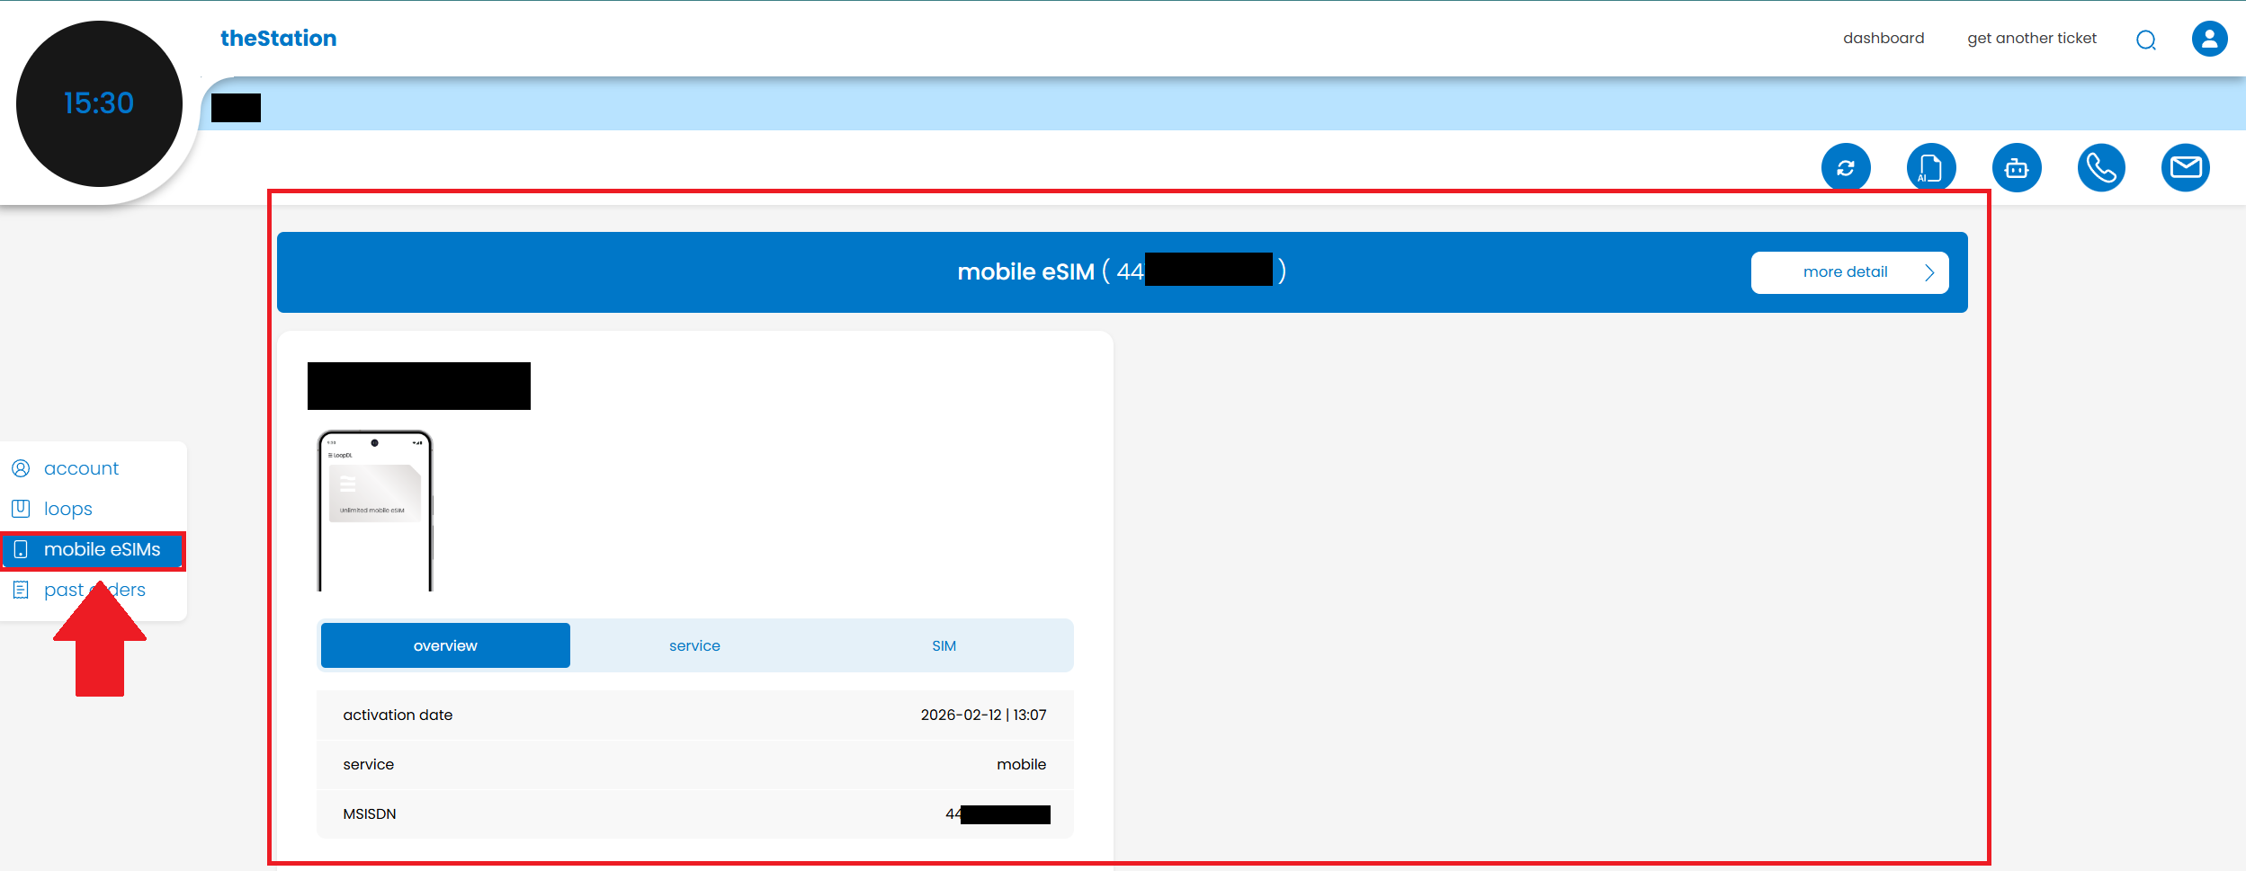
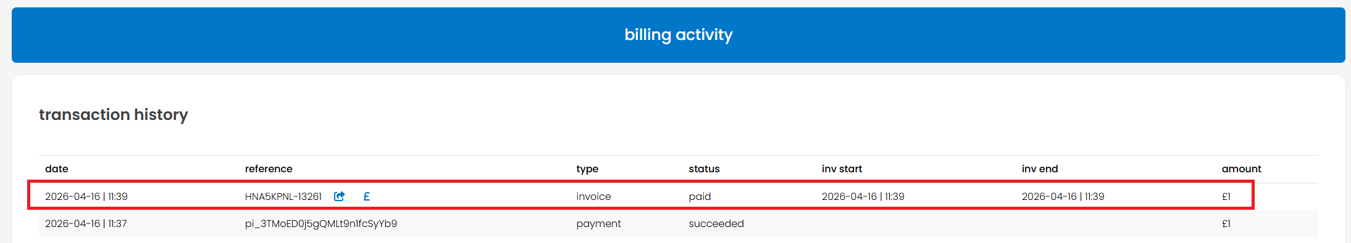
Network
e-SIM Provision
Things we check ask the customer, check in the station, etc. 1. Check if the order was placed under services 2. Check if the payment was successful 3. Check if the device is e-SIM compatible 4. Check if the customer is currently in the UK

Slide 12
Network
e-SIM Provision
Troubleshooting e-SIM Ask the customer to reboot the device Uninstall and Reinstall the loopDL app Escalate the ticket if it is still not visible on the station/customer's end.
If the phone is not e-SIM compatible, let the customer know so they may best decide on what to do next
If the customer is not in the UK – Mention that we only cater UK customers, then continue with other concerns.

Slide 13
Network
Transfer e-SIM /
e-SIM not working
Things we check ask the customer, check in the station, etc. Confirm e-SIM is fully deleted from the old phone If not, ask if they still have access to it Ask where the customer bought the phone (within the UK?) Check if the device supports e-SIM Get the Make and model of the phone and ask google or go to gsmarena.com and check if the phone supports e-SIM Verify if e-SIM is allocated on the Loop; mobile device
If the customer does not have access to the old phone anymore
If they want to recover the e-SIM. Escalate for backend to try to recover the e-SIM.
If they agree on a sim swap. Escalate for sim swap approval.
make sure the e-SIM is not ported, otherwise do the former.

Slide 14
Network
Transfer e-SIM /
E-SIM not working
Troubleshooting (e-SIM Transfer Steps) Delete e-SIM from old phone Open Settings Tap Cellular or Mobile Data Tap SIMs or Cellular Plans Select the e-SIM Tap Delete e-SIM / Remove Cellular Plan Tap Confirm Install e-SIM on new phone Open the app Sign in Select Install e-SIM Follow on-screen instructions (If it did not work) Uninstall e-SIM/LoopDL app Reinstall e-SIM/LoopDL app
If issue persists, do not sim swap -> Escalate

Slide 15
Network
Adult Content
Things we check ask the customer, check in the station, etc. Positioning: "Unfortunately, this is not a setting we can change or disable on your behalf. To resolve this, kindly follow the steps below to turn off the Adult Content filter:" Log in to your account Go to My Account Select Profile Click on Manage Device Go to My Plan Toggle OFF the Adult Content Filter Once you turn it off, a pop-up with a website link will appear. (Continue to next slide)

Slide 16
Network
Adult Content
Things we check ask the customer, check in the station, etc. Tap the link and follow the steps to complete verification: Enter your details Upload a valid ID for age verification Note that this verification is completed via the UK verification site and not through Loop. After completing the process, customers must restart their phone to ensure the changes take effect. Even if the Adult Content or parental filters are disabled, certain websites may still be blocked at the network level. These include sites hosting illegal content (such as those identified by the Internet Watch Foundation) and websites restricted under UK court orders (e.g., copyright-infringing or piracy sites). These restrictions are required by UK law and cannot be removed. However, legal adult, gambling, dating, and other age-restricted websites should be accessible once the filter is turned off, unless they fall under legal blocking requirements.

Slide 17
Network
How to reset network settings on an iPhone
Steps: Go to Settings General Transfer or Reset iPhone Reset Reset Network Settings.

Slide 18
Network
Steps to Manually Connect Vodafone UK e-SIM
Things we check ask the customer, check in the station, etc. Confirm e-SIM is fully deleted from the old phone Ask where the customer bought the phone (within the UK?) Check if the device supports e-SIM Get the Make and model of the phone and ask google or go to gsmarena.com and check if the phone supports e-SIM Verify if e-SIM is allocated

Slide 19
Network
Use a 3rd party SIM on loop
Things we check ask the customer, check in the station, etc. Process to Follow (Customer Side) Ask the customer to get the following from their previous provider: E-SIM QR Code or LPA (activation code) ICCID of loop Instruct the customer to send these details to: support@loopdl.co.uk Process on theStation (Agent Side) Find the customer and their device on theStation Go to Action Station > Device > Add e-SIM Copy and paste the e-SIM code (LPA) Click Add e-SIM Monitor the SIM status to confirm successful installation
Make sure to add the LPA
Eg. "LPA: abcd"

Slide 20
Network
Sim Card Expired
Things we check ask the customer, check in the station, etc. Initial Checks Verify e-SIM Support - Ensure your specific phone model supports e-SIM. While many modern rugged phones do, some regional variants may not. Check by going to Settings > About Phone and looking for an EID number. Stable Internet: A strong WI-FI connection is required to download the e-SIM profile. Switch off mobile data and ensure WI-FI is stable. Remove VPNs: Disable any active VPNs, as they can block the activation server. Troubleshooting Installation Use Manual Entry: If the QR code fails, use the manual activation details(SM-DP+ Address or activation string, Activation Code) provided by your carrier. Restart and Retry: A simple restart can fix stuck Äctivating...""prompts. Check for Software updates: Go to Settings > System > System Update to ensure the phone has the latest software. Reset Network Settings: Go to Settings > System > Reset options > Reset WI-FI, mobile a& Bluetooth. This can clear corrupted network data.

Slide 21
Network
Sim Card Expired
Troubleshooting Installation Activating the eSIM Enable Data Roaming: If you are using a travel e-SIM, you must enable data roaming in the settings for that specific e-SIM profile. Toggle Airplane Mode: Turn on Airplane mode for 30s, then off to refresh connections. Select Network Manually: If it does not automatically connect, go to: Settings Network & Internet SIMs [Your e-SIM] Network operators and choose the supported network

Slide 22
Network
Using LSA String (manual)
*** ON HOLD ***
Things we check ask the customer, check in the station, etc. Go to Settings Tap Network & internet Tap SIMs Tap + Add SIM Tap Don't have a SIM card? Tap Enter code manually Paste or type your LSA string: See activation string in Station Tap Connect / Add Wait for the profile to download Tap Activate / Turn on Restart your phone"
The process is currently on hold
Until further update is given, please refrain from using it.

Slide 23
Network
Delete e-SIM (Android, Samsung)
Steps: Go to settings Tap Connections Tap SIM manager Under e-SIMs, tap the e-SIM profile you want to delete Tap Remove and confirm

Slide 24
Network
“Device Is Not e-SIM Compatible” (iOS)
Things we check ask the customer, check in the station, etc. Check the make and model is e-SIM compatible Check if sim swap was made Troubleshooting Steps: Step 1: Remove existing LoopDL e-SIMs Go to Settings Tap Cellular / Mobile Data Delete all LoopDL eSIM profiles Step 2: Reinstall the app (max 2 attempts) Install the app again If successful, check: Calls, Data & Text/SMS If issue persists: Restart the iPhone Try installing again Restart the phone after the second attempt 🔁 Restarting helps refresh the network and complete e-SIM setup. If STILL not working after max 2 attempts, escalate.
⚠️Only remove LoopDL e-SIMs.
Do not delete other SIMs unless advised

Slide 25
New
Onboarding process
Steps: Onboarding new devices Run speed test and optimization in theStation Checking experience Verify connection speed with the customer Getting customer feedback Confirm satisfaction and overall experience with the product and service Move to healthy

Slide 26
Billing
Make Payment
Things we check ask the customer, check in the station, etc. Check the expiration date of the card on file Verify the last four digits of the card What to do next: Tell the customer that the payments are processed via saved card details or by entering new payment information at checkout. If the customer has an active subscription, payments are charged automatically monthly

Slide 27
Billing
Customer can't pay
Things we check ask the customer, check in the station, etc. Check the card expiration date. Review the error message. Check the transaction history What to do next: Tell the customer that the payments are processed via saved card details or by entering new payment information at checkout. If the customer has an active subscription, payments are charged automatically monthly
If the customer wants PTP, let them know that it is a great idea, treat it as a feedback which we will send to our team.
This will otherwise be edited if PTP process is implemented

Slide 28
Billing
Amount check
Things we check ask the customer, check in the station, etc. Check the total amount to be paid on the invoice or on the station >> Check the station for invoice What to do next: Tell the customer to visit the LoopDL website. Inform to check the invoice and that payments are always upfront.

Slide 29
Billing
Amount check
Things we check ask the customer, check in the station, etc. Check the expiration date of the card on file Verify the last four digits of the card What to do next: Tell the customer that the payments are processed via saved card details or by entering new payment information at checkout. If the customer has an active subscription, payments are charged automatically monthly

Slide 30
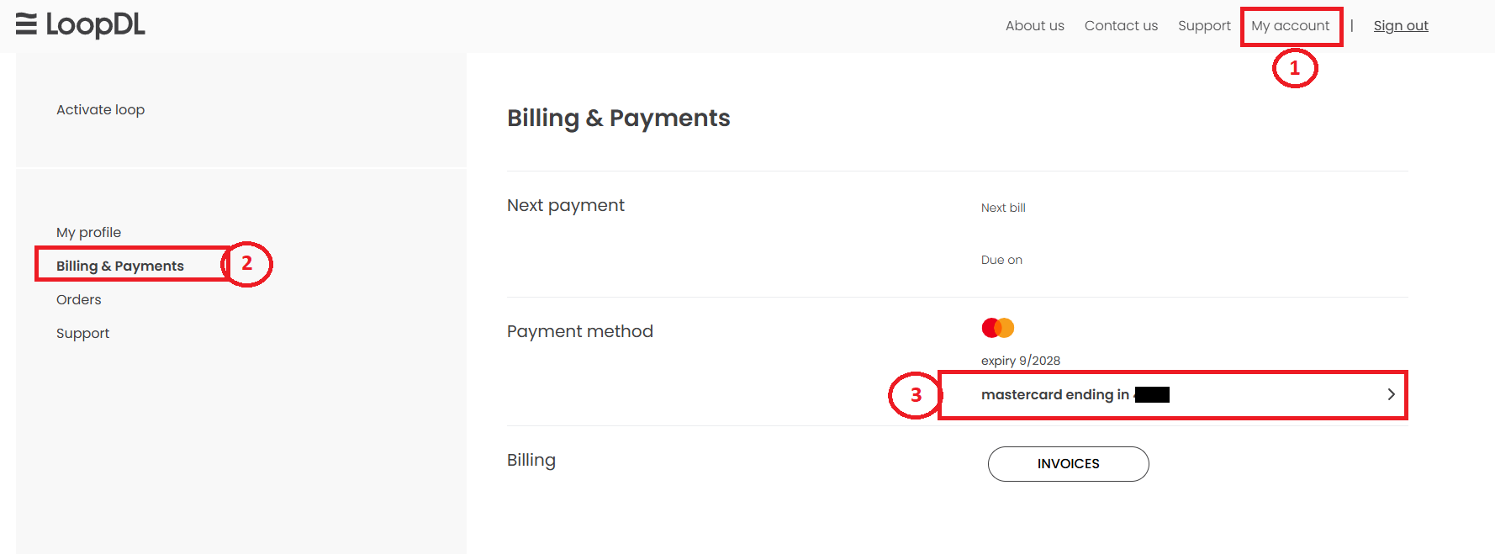
Billing
Update Card Details
What to do next: Customers can update their card details by logging into their account on loopdl.co.uk. Go to: My Account Billing & Payments Click on the card You will be asked "Do you want to update your card details?" Process the edit and confirm

Slide 31
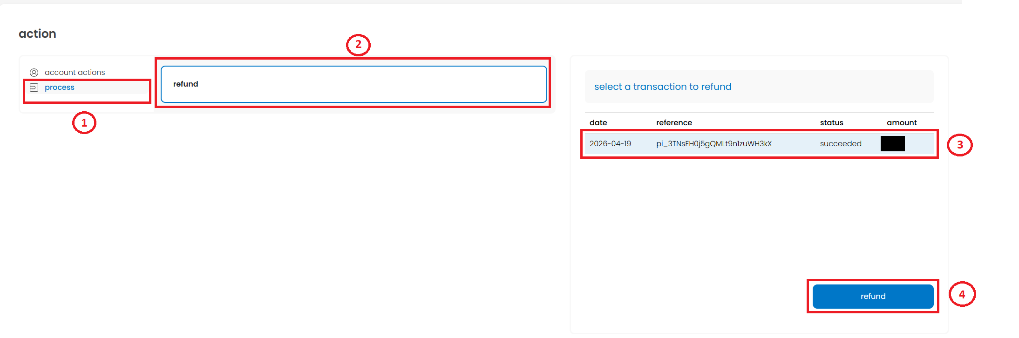
Billing
Refund
Things we check ask the customer, check in the station, etc. Check if the refund is valid Check timestamps Reason(s) as to why the refund is necessary What to do next: Ask support for permission to refund (£1 is not refundable) If approved, process refund Disclosure: Advise the customer that after we process the refund on our end, it takes 7-10 business days for them to receive the refunded amount. This depends on their bank.

Slide 32
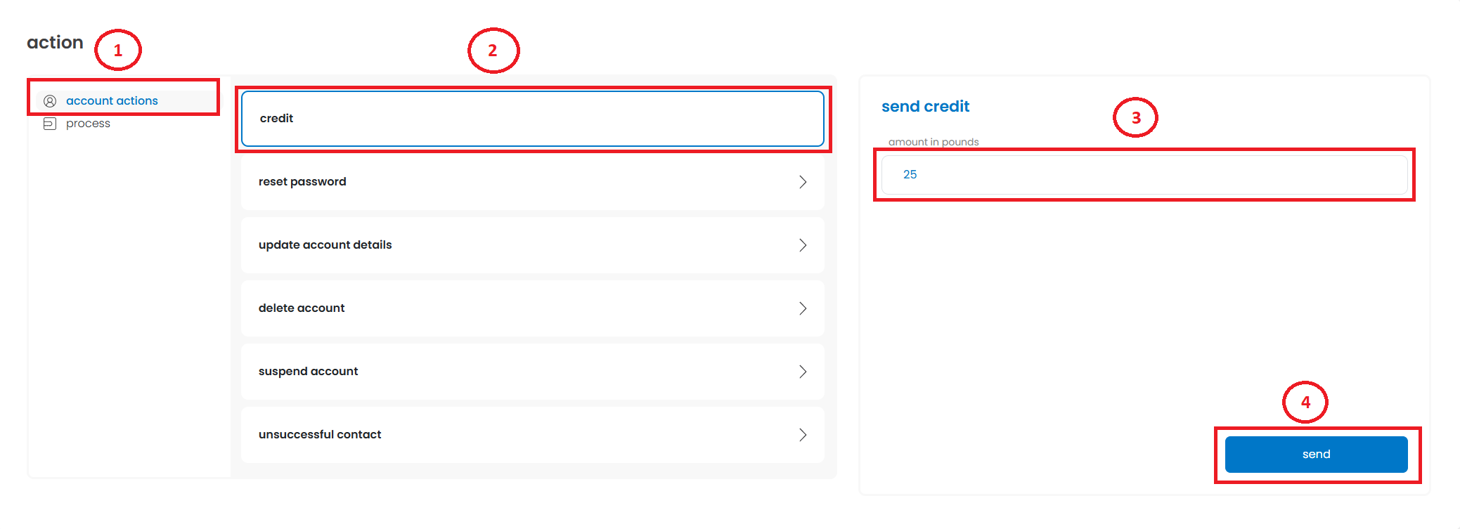
Billing
Credit/Compensation
What to do next: Verify the credit reason, double check on theStation if reason is valid Escalate to Team Lead for approval If approved, process the credit on theStation

Slide 33
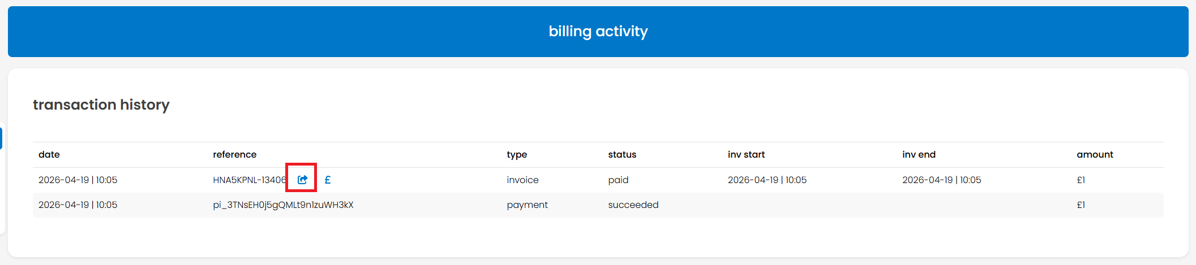
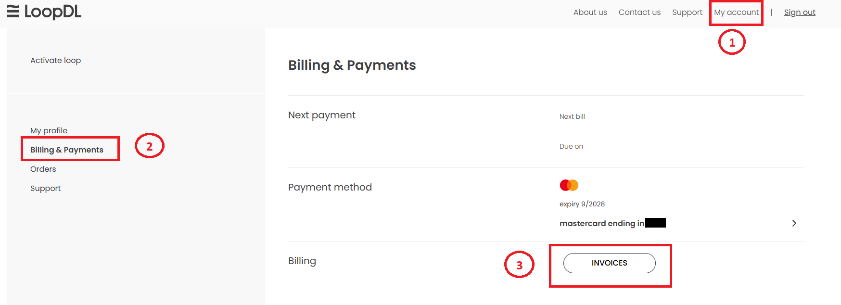
Billing
Invoice
Things we check ask the customer, check in the station, etc. Confirm which month(s), the customer, need the invoice(s) for. What to do next: Verify if the customer's email address is correct Send the invoice to the customer via theStation Let them know that it will be sent through email Advice self-service options for future invoice checks, to loopdl.co.uk.

Slide 34
Billing
Bill Dispute
Things we check ask the customer, check in the station, etc. Verify the reason for the bill dispute • bill details (billing period, due date and amount) • disputed charge (incorrect amount, duplicate, unrecognize charges) • contract • usage What to do next: Escalate to Team Lead if valid Process credit; refund depending on the situation Follow process for refund or Credit/Compensation

Slide 35
Billing
Proof of Payment
Things we check Information needed on the Proof of payment Payer's information Payment details (date and time, amount Transaction reference Payment status What to do next: Escalate to Team Lead if valid Wait for update Process credit; refund depending on the situation Follow process for refund or Credit/Compensation

Slide 36
Billing
Reactivation
(With free service)
Things we check ask the customer, check in the station, etc. Customer's account is in pending cancellation status There is still remaining free service The customer wants to reinstate the service What to do next: Revert the cancellation in theStation If it does not go through, ask assistance from TL If reinstated, check if service is working. If not: Loop - reset loop to activate the account on their end e-SIM - ask the customer to reboot phone if the service is still not active

Slide 37
Billing
Reactivation
(Inactive account)
No payment made yet
Things we check ask the customer, check in the station, etc. Customer's account is inactive due to non-payment Customer wants to reinstate account What to do next: To reinstate your service, you won't need to purchase a new device, as your existing Loop device is already linked to your account. Instead, please do the following:
** if step above fail please proceed further If all fails, process factory reset (for TL approval) and sign in again with google. On the station under configured e-SIM, click on resend e-SIM Go to number 5 and follow the prompts.
(If the LoopDL app is not present on the Loop device, download from the playstore.)
log in to your account at loopdl.co.uk (https://www.loopdl.co.uk/sign-in-or-register)
navigate to My Account → Manage → My Subscription
From there, you should see an option to reactivate or resubscribe to the Unlimited Data plan. Once the subscription has been successfully reactivated, your service should resume on your current device.
From there, you should see an option to reactivate or resubscribe to the Unlimited Data plan. Once the subscription has been successfully reactivated, your service should resume on your current device.
Notes:
Previous steps on the app
Open the LoopDL app (Loop Device)
Navigate to app options
Click on devices
Click on the loop you wish reinstate
On the loop, they should see “Tap to activate or reinstate” option.
Follow the steps and pay the amount showing to reactivate.
Once plan is paid for the loop will automatically activate the new sim.
** if step number 7 fail please proceed further
8. If all fails, process factory reset (for TL approval) and sign in again with google.
9. On the station under configured e-SIM, click on resend e-SIM
10. Go to number 5 and follow the prompts.

Slide 38
Billing
Wall Garden
(Payment made but service is inactive)
Things we check ask the customer, check in the station, etc. Payment made after due date Service shows inactive What to do next: Escalate to Support to reinstate the service If service is reinstated, contact customer to see if the service is working If it works, close the ticket If not, advice the customer to logout of the app and reinstall the app If it works, close the ticket If not, escalate to support

Slide 39
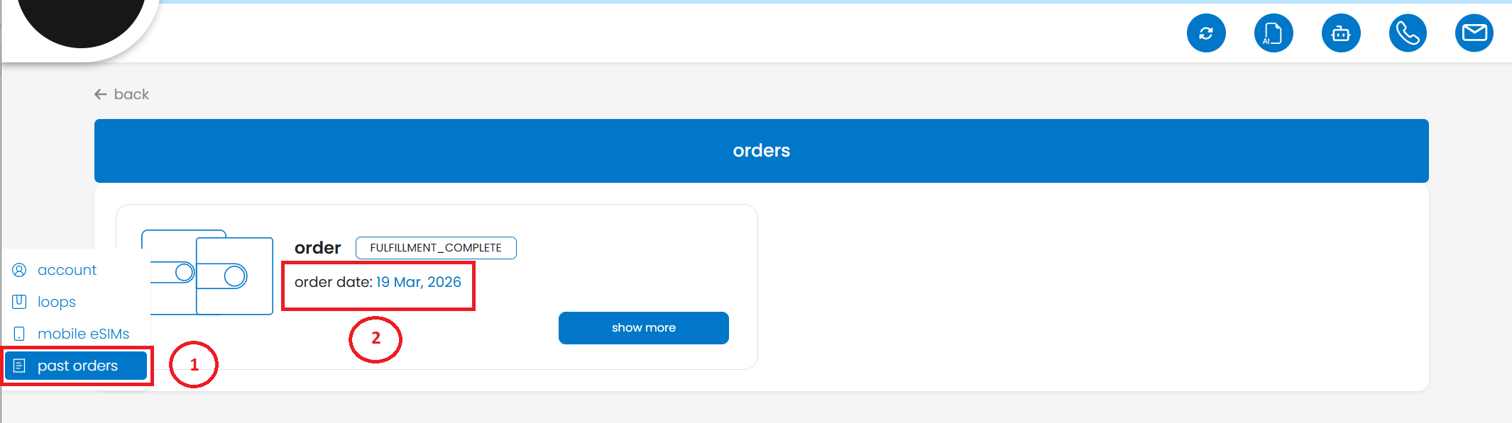
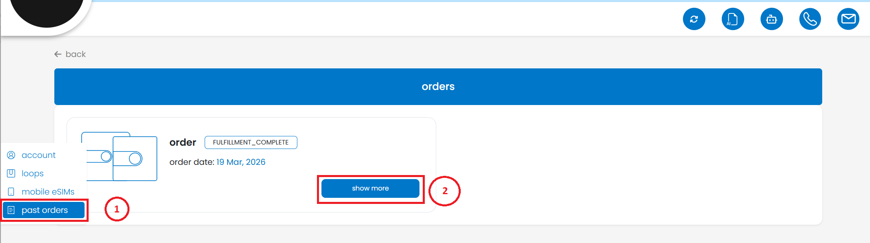
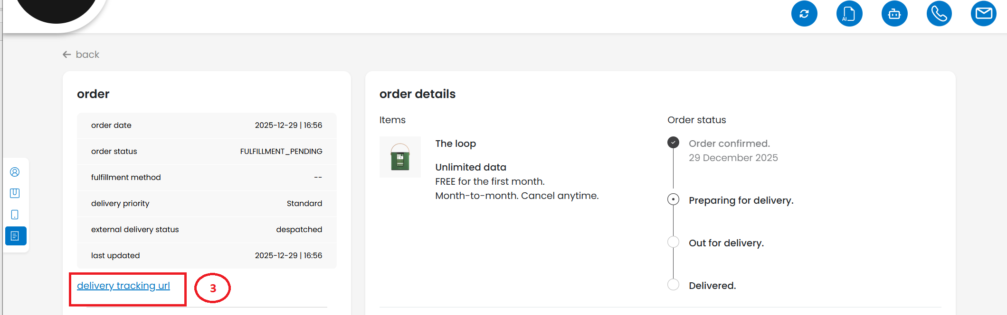
Logistics
Where is my delivery
Things we check ask the customer, check in the station, etc. Order date Tracking URL

Slide 40
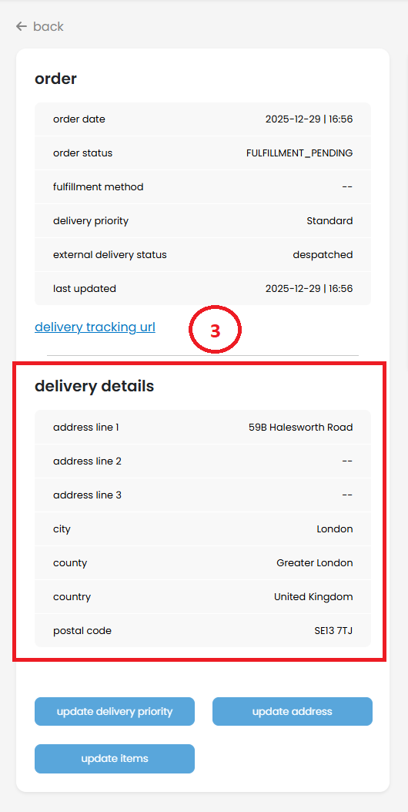
Logistics
Where is my delivery
What to do next: Verify if the delivery address on the system is correct.
If the address is not correct, follow change of address process

Slide 41
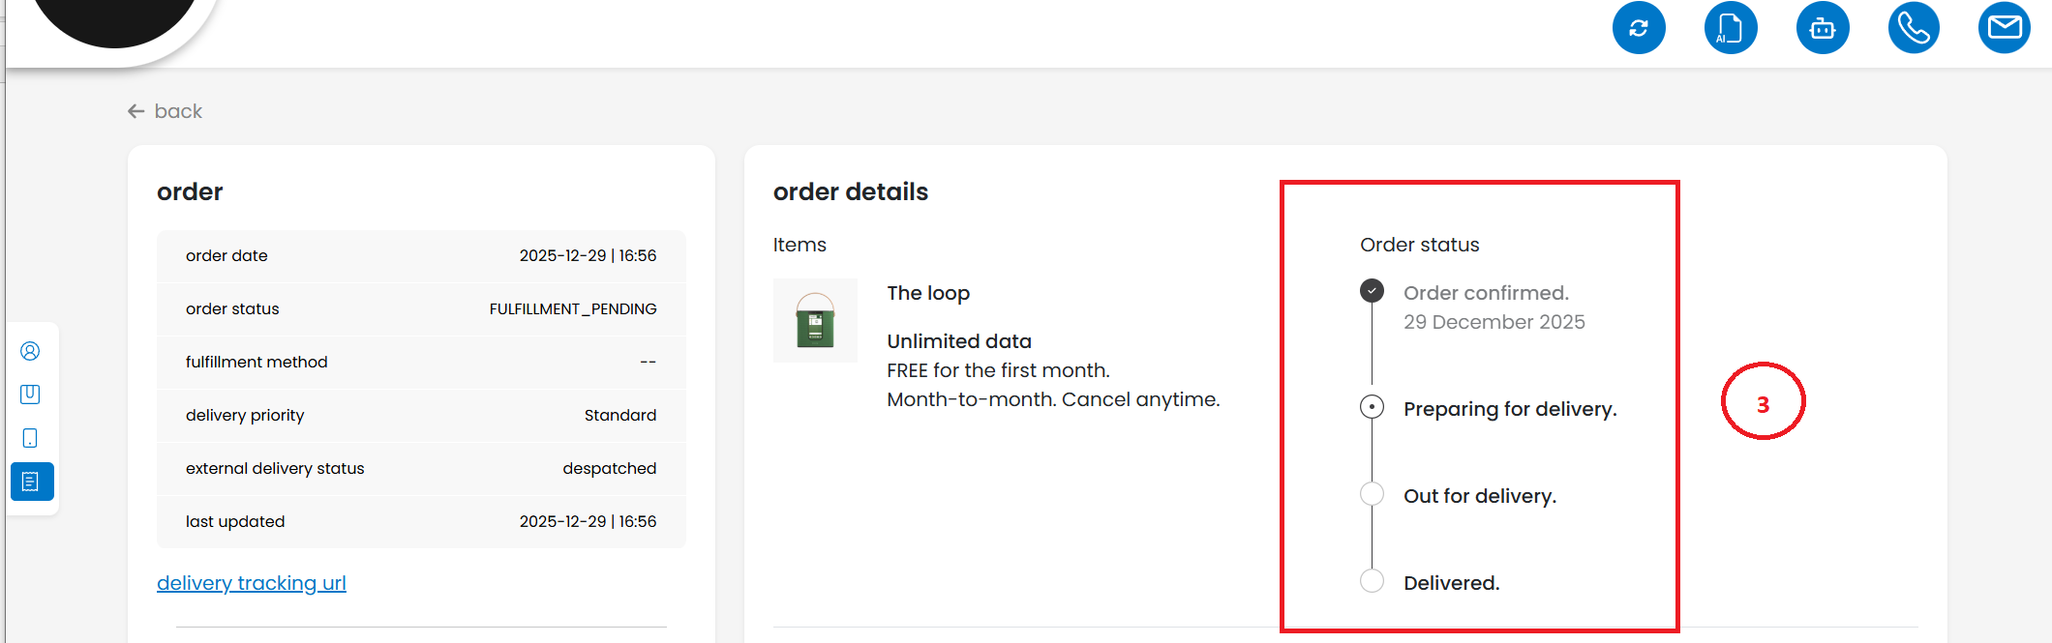
Logistics
Change of address
Things we check ask the customer, check in the station, etc. Order status

Slide 42
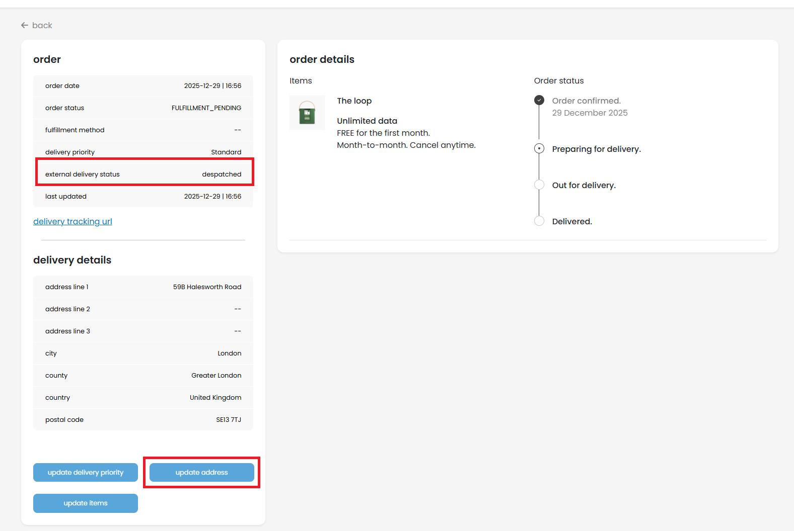
Logistics
Change of address
What to do next: 2. Change delivery address
Despatched – we cannot change the address anymore since the delivery is on route.
Others – change address

Slide 43
Logistics
Failed delivery
Things we check ask the customer, check in the station, etc. Verify Delivery address
If the address is not correct, follow change of address process

Slide 44
Logistics
Returns
Things we check ask the customer, check in the station, etc. Verify if the services are cancelled Ask for the reason of the loop return What to do next: Escalate to UK Support internally

Slide 45
Logistics
Replacements
Things we check ask the customer, check in the station, etc. Ask for the reason of the loop replacement Verify the issue (what happened) Verify if replacement is valid Customer-induced (not valid) Issue upon delivery (Valid) What to do next: Verify the delivery Address Escalate to support

Slide 46
Logistics
Fast delivery request
Things we check ask the customer, check in the station, etc. Order Date Order Status Tracking URL What to do next: Verify the delivery Address Escalate to support

Slide 47
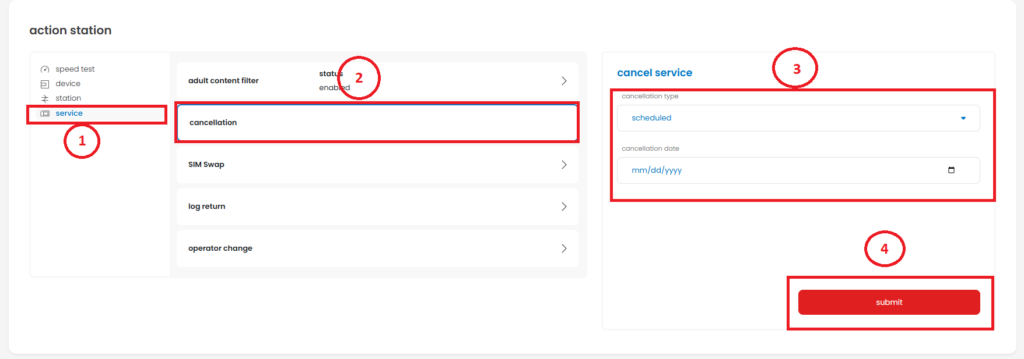
Cancel
Cancellation Reasons
Cancellation Reasons Affordability, Found better deal, change of heart Process scheduled cancellation Network, Coverage Run Speed Test Troubleshoot, including restart and hard reset Issue resolved, try to retain customer Issue persists Customer insists on cancellation Process scheduled cancellation Customer wants to troubleshoot Go to Network troubleshooting

Slide 48
Cancel
Cancellation Reasons
Cancellation Reasons Incompatibility Check the mobile phone make and model and check for compatibility Compatible Check the activation Status Follow Activation procedure Incompatible Try to retain customer by asking to install the app on other phone Retain, ok Customer declined, process scheduled cancellation

Slide 49
Cancel
Cancellation Reasons
Cancellation Reasons No reason stated Call the customer and ask for the reason for cancellation Refer to the above cancellation reasons

Slide 50
Account
Password Reset
Things we check ask the customer, check in the station, etc. Verify if the customer is the account owner. Account holder / customer verified account – proceed to next step Another person / cannot verify account – let the account holder contact us Confirm the email address added. Verify email if created manually or using Google or Apple" What to do next: Advise the customer to change it via the LoopDL app or website, then click “Forgot Password.” on the login page If it's not working on the customer's end and email was created manually, do the following steps: On the station under account tab, click account actions and choose reset password and click the send button Ask customer to check their email for the 4 digit code Click the link to go to the LoopDL website and click sign in Click forgot password Type in the 4 digit code together with the new password and confirm password then hit continue. If using Google or Apple, advise to follow password reset guidance such as using passkey, etc.

Slide 51
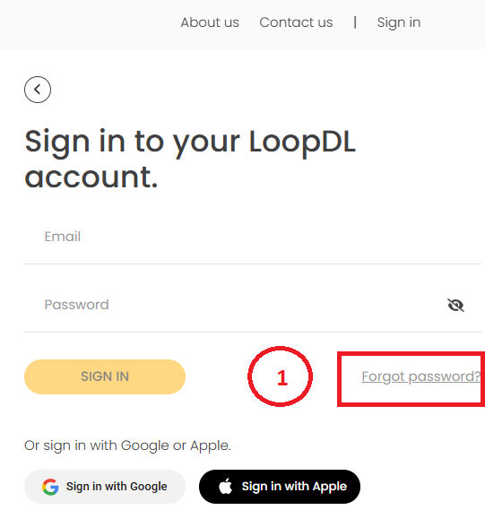
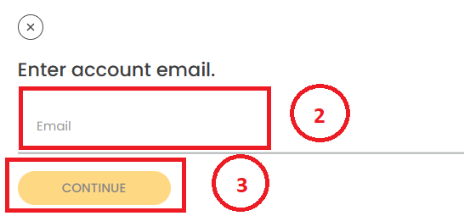
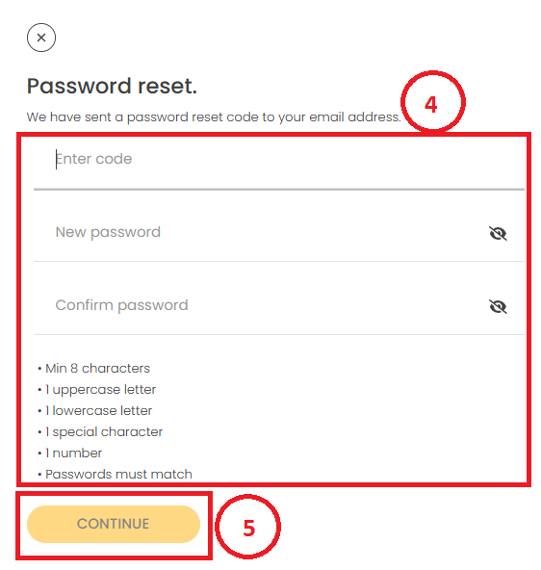
Account
Password Reset
Password reset guide on the LoopDL site:

Slide 52
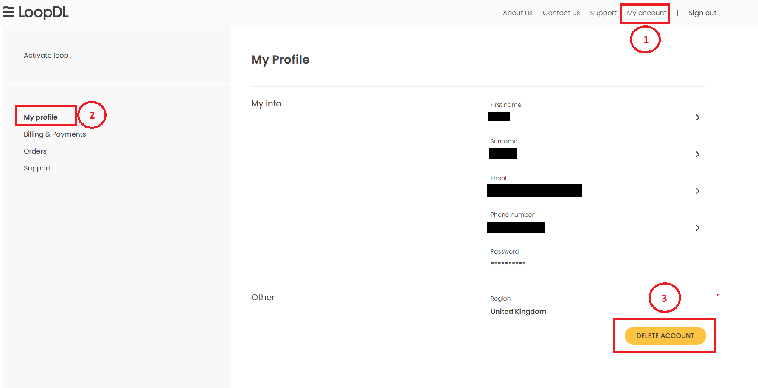
Account
Account deletion
Things we check ask the customer, check in the station, etc. Ask what error message they are getting when deleting their account online Check if there's still an active service or subscription What to do next: Educate that it needs to be done by the customer through their online account portal at loopdl.co.uk. Advise they can try to delete their account after the cancellation date.

Slide 53
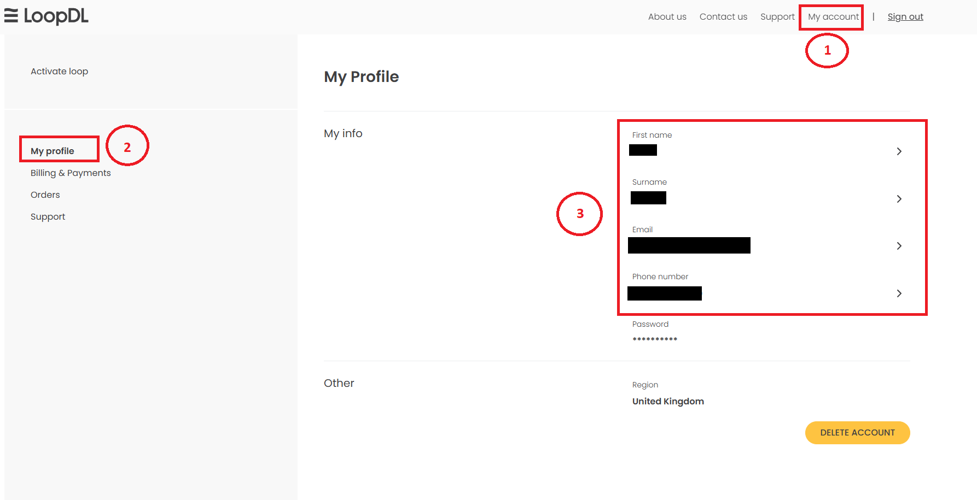
Account
Change details
Things we check ask the customer, check in the station, etc. Verify if the customer is the account owner. Verify the Last 4 digits of card on file and expiration date Confirm the email address on the account What to do next: Let the customer know that this must be done through their online account portal at loopdl.co.uk under My Account settings.

Slide 54
Porting
Port-in
Things we check ask the customer, check in the station, etc. Number to port IN or MSISDN PAC code from previous provider MSISDN active during porting process What to do next: Navigate to burger menu on top right corner Click on Sign in Sign in to the loopdl.co.uk site Go to my account and click the plus button for drop down menu options Click manage to open active plans Click the drop-down menu on Number Porting options Click on port in and follow the steps provided Insert the number requesting to Port in and PAC code related to it and following the any other steps provided. Educate customer of the porting process may take up to 48 business hours and that the service will be interrupted during the process (loss of service to the number being ported - both LoopDL and previous provider) If having issue/error inform TL and escalate the issue to proceed with Manual porting.

Slide 55
Porting
Port-out
Things we check ask the customer, check in the station, etc. Number to port OUT or MSISDN PAC code from LoopDL MSISDN active during porting process What to do next: 1. Check for outstanding balance — port-out is not recommended while in arrears, but is possible 2. If balance exists and customer insists: TL discretion to credit. If approved, help customer request PAC from self service . 3. If the LoopDL number was previously ported in: PAC is provided by TL/SIM GO (it comes from the provider). 4. If it's a native LoopDL eSIM: customer can self-serve the PAC via the website or app or by sending SMS to 65075 5. Confirm the PAC and expiry with the customer and remind them their service will end on cutover. Ask when they ported out (date of porting request) Advise the customer that porting should be completed after 48 business hours. (not including weekends and holidays)

Slide 56
Device
Device related issues
Issue: Not charging Ask checklist / TS Connect to a different power outlets inside the house Make sure the power cords are connected properly not loose Check the physical condition of the power cord Use different power cords Check for any physical damage and/ or any deterioration of the loop If loop still does not charge after TS, escalate to support Fast Battery drain Ask checklist / TS Battery saver is turned off Battery calibration done (charged 3 times, still depletes fast) Tried a different power cable Tried a different power outlet Performed factory reset Observe for 24 hours if issue persists, escalate to support
NOTE: If the customer has received the device faulty, proceed to:
Logistics -> Replacements

Slide 57
Device
Device related issues
Issue: No Sound, Crashing, Constant reboot Ask checklist / TS Reboot Factory reset Navigate the Loop Device Turn on the LoopDL device. Open the Settings menu. Navigate to System > Reset options. Select Erase all data (factory reset). Confirm the action to start the reset. If the device is unresponsive, follow these steps: Ensure the device is powered off. Press and hold the Power button and Volume Up button simultaneously for several seconds. When the Android recovery menu appears, use the volume buttons to navigate to "Wipe data/factory reset". Press the Power button to confirm. Select "Yes" or "Factory data reset" to confirm, then choose "Reboot system now" once completed. If issue persists, escalate to support Disclosure: A factory reset will erase all stored data, custom settings, and Wi-Fi configurations, returning the device to its original state.
NOTE: If the customer has received the device faulty, proceed to:
Logistics -> Replacements

Slide 58
Device
Device related issues
Issue: Application issue Ask checklist / TS Uninstall/Install Reboot Factory Reset If issue persists, escalate to support
NOTE: If the customer has received the device faulty, proceed to:
Logistics -> Replacements

Slide 59
No issue
No issue stated on the ticket
Issues: The customer is requesting not to be called; wants email communication only Make one call attempt if unanswered, Escalate to Support If customer mentioned a concern, go to the guide for the said issue and try to resolve the it.

Slide 60
DNC
Do not Call
Check if contact number is in UK or non-UK UK customers Check AI LoopDL interaction to verify the issue and means of communication. Call the customer once If the customer cooperates on the call, then select the issue within the slides and help resolve their issue. If the customer answers and is not cooperative because of the DNC, escalate If the customer does not answer, escalate for email communication Non-UK customers Check AI LoopDL interaction to verify the issue and means of communication. Call the customer once Advice that we only cater to UK based customers Set account for scheduled cancellation if not yet scheduled If the customer answers and is not cooperative because of the DNC, escalate If the customer does not answer, escalate for email communication

